Slide 1
Speaking Up for Every Child

Slide 2
A Vision for New Mexico Schools
Families understand their rights and responsibilities under federal and state laws.
Families understand how the school and district operates and are provided resources to help them navigate the educational system.
Families and school staff develop capacity to be effective advocates for their children and the whole student population.
Policies and procedures are in place that encourage smooth transitions between and within schools.

Slide 3
There are Two Main Goals for Speaking Up for Every Child
Share information about student progress.
Empower families to support their own and other children’s success in school.

Slide 4
Speaking Up for Every Child
School staff and parent groups can make a critical contribution to student success by ensuring that all students have an advocate, whether it’s a family member, teacher, or community volunteer.
They also can contribute to student achievement by offering opportunities for families to participate in Parent Advisory Teams while learning and practicing skills necessary to speak up for children and youth.

Slide 5
Share Information About Student Progress
Key Questions to Consider
Parents must know how the local school and district operate and how to raise questions or concerns about school and district programs, policies, and activities. They also must understand their rights and responsibilities under federal and state law and local ordinances and policies. Key questions include:
Do parents know what school staffs do and who to contact for information?
Do parents know the legal rights of students?
Do parents know how to get a problem resolved?

Slide 6
Empower families to support their own and other children’s success in school
Key Questions to Consider
Parents must be prepared to monitor students’ progress and guide them toward their goals so students graduate from high school ready for postsecondary education and a career. Key questions include:
Are parents offered opportunities to learn how to make the best choices for their children’s education?
How often do counselors and advisers meet with each student?

Slide 7
Resources Toolkit http://nmengaged.com/resources-toolkit/
RESOURCES TO SUPPORT THE FRAMEWORK FOR FAMILY-SCHOOL PARTNERSHIPS IN NEW MEXICO
Use these tools to support your work. They are categorized by general resources and each of the six focus areas. They are designed for the following:
Reflection on practice
Inclusion in school websites and newsletters
Use with families and students
Professional development
Planning and implementing an action plan

Slide 8
Speaking Up For Every Child
School Level Reflection Rubric for Speaking Up for Every Child
Refer to the School-Level Reflection Rubrics for the areas that you have identified as priorities. These will be helpful in examining what good practices look like and developing ideas for partnership practices and activities as you develop an Action Plan.
The School-Level Reflection Rubrics can also be used to monitor progress in reaching goals, designing professional development for school staff, and conducting a school walk-through.
The levels of practice build on each other, assuming that practices in the emerging and professing levels will continue at the next level.

Slide 9
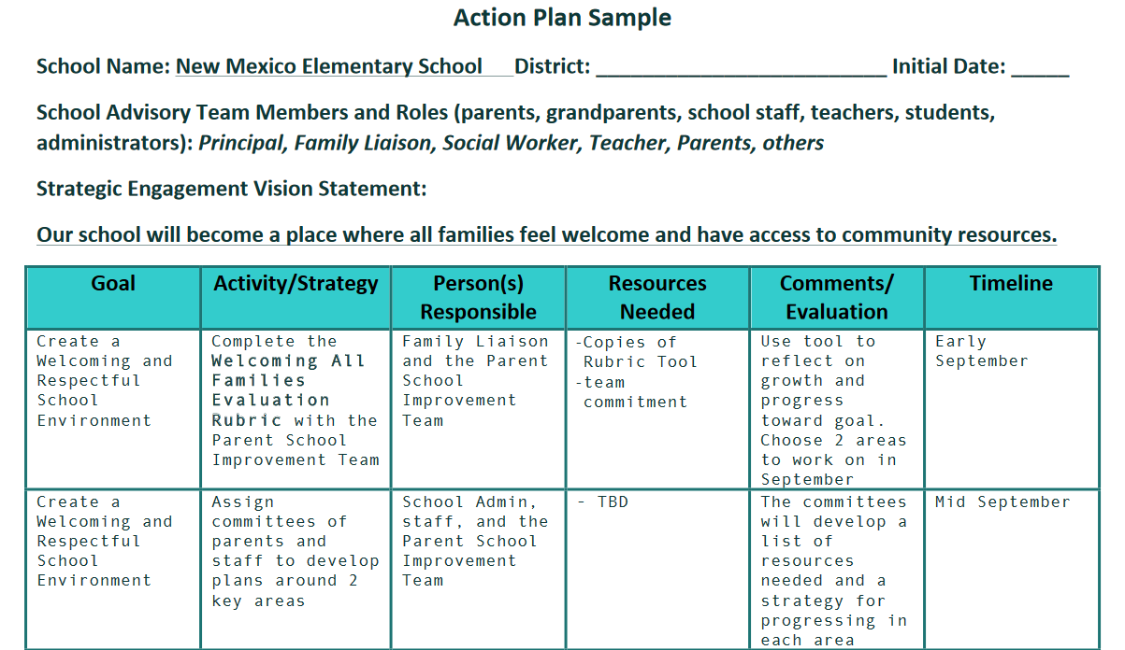
How does this Framework Focus Area fit into your Action Plan?

Slide 10
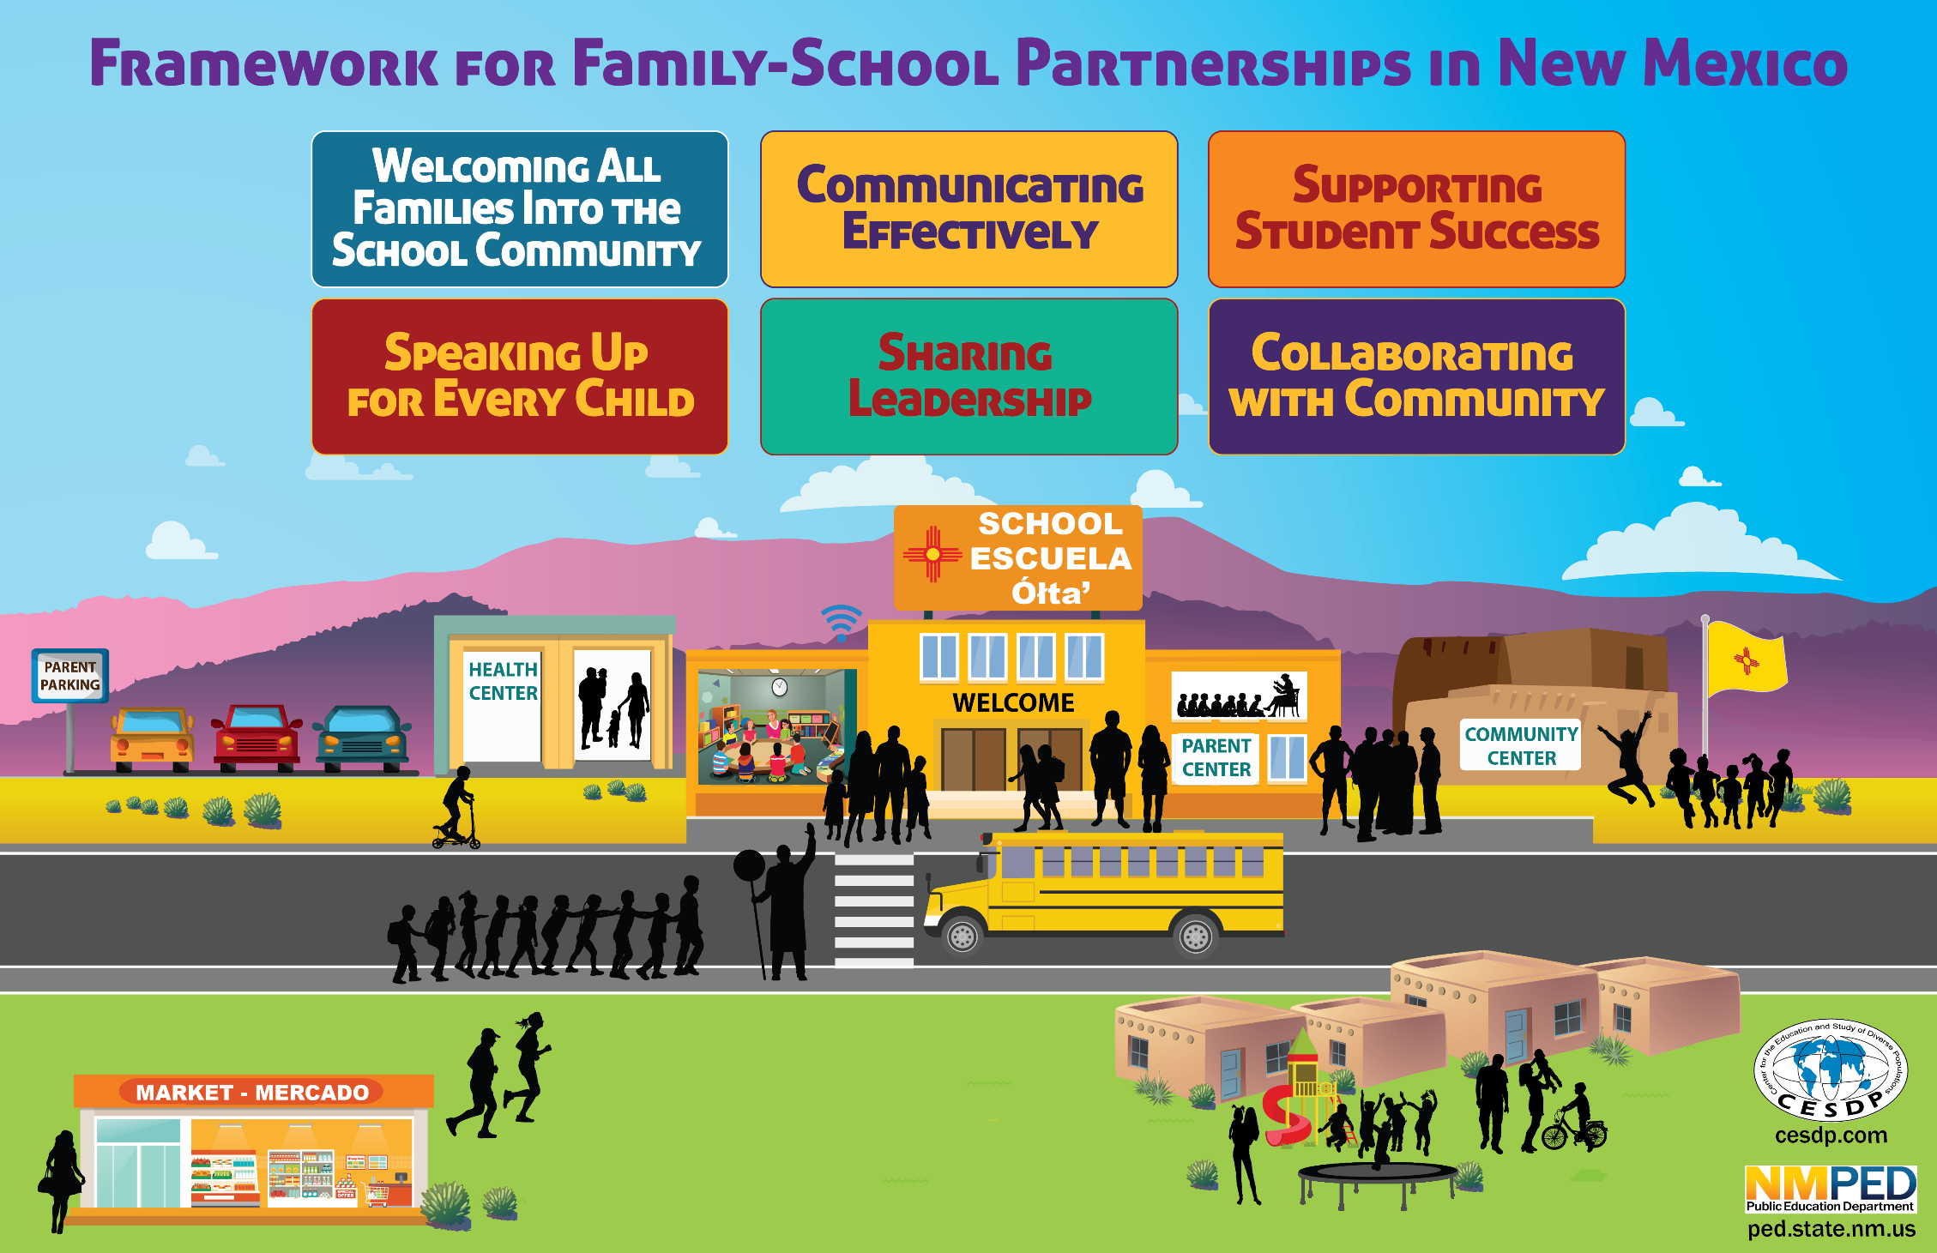
NMengaged.com
Notes:
Thank you for your time and I look forward to meeting up with you again in Step 2!

